Slide 1
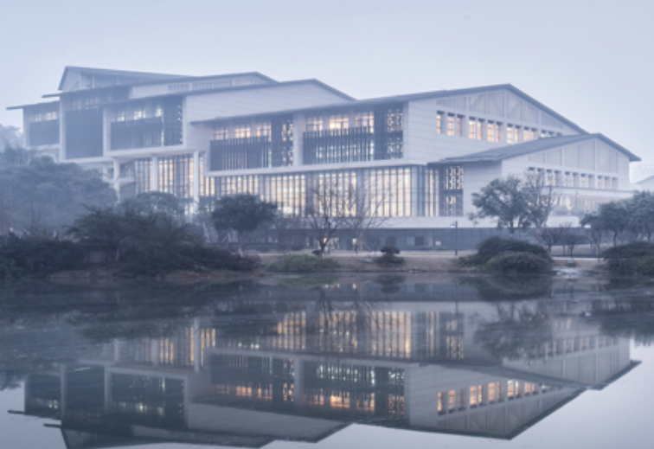
Chongqing University of Technology
ATAI
Advanced Technique of Artificial Intelligence
Chongqing University of Technology
Feature Projection for Improved Text Classification（ACL 2020 ）
彭展望
Code:https://github.com/Qqinmaster/FP-Net/

Slide 2
Outline
Introduction
Related Work
Method
Experiment
Conclusion

Slide 3
Introduction
Phenomenon:
good features：”good”、”nice”、”bad”、”terrible”
common features: “voice”、”screen”
The solution:
This method projects existing features into the orthogonal space of the common features.

Slide 4
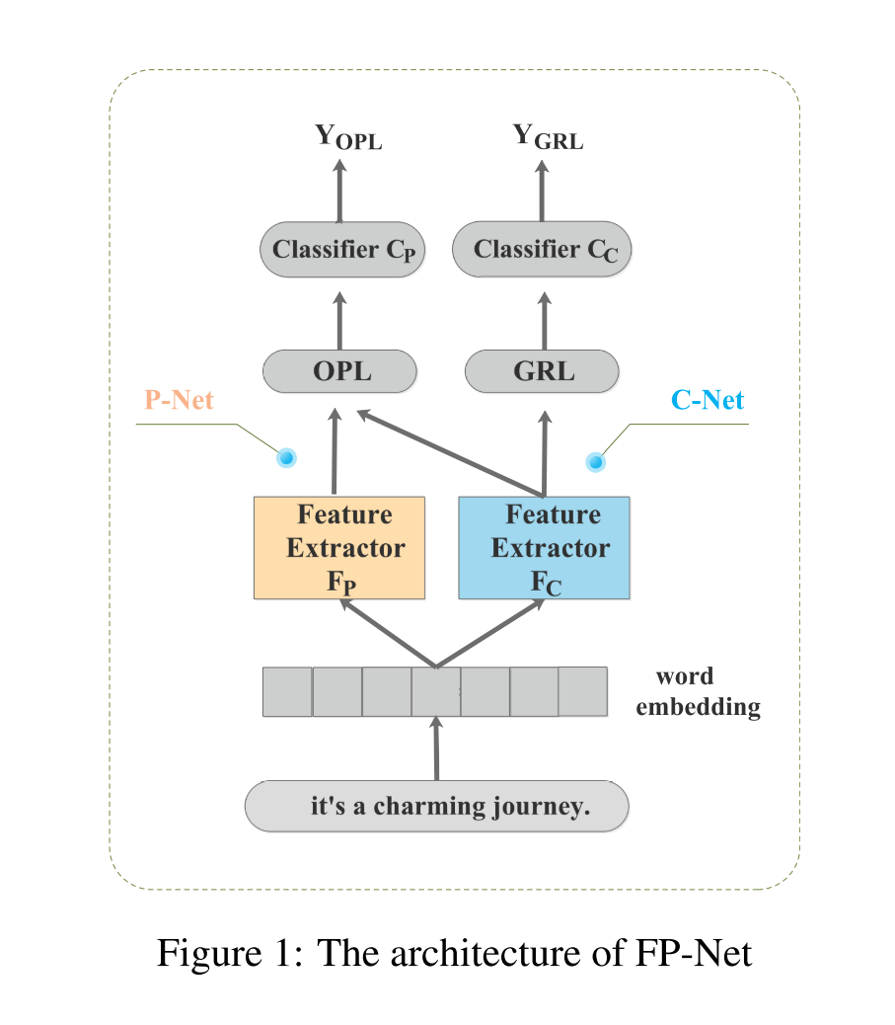
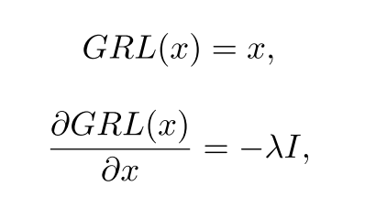
Method
C-net: common feature learning network
Gradient Reverse Layer：论文： 《Unsupervised Domain Adaptation by Backpropagation》（ICML2015)

Slide 5
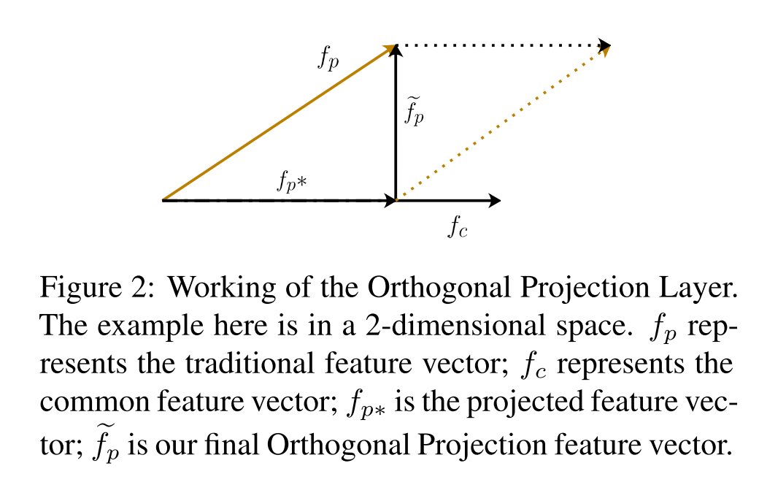
Method
P-net: projection network

Slide 6
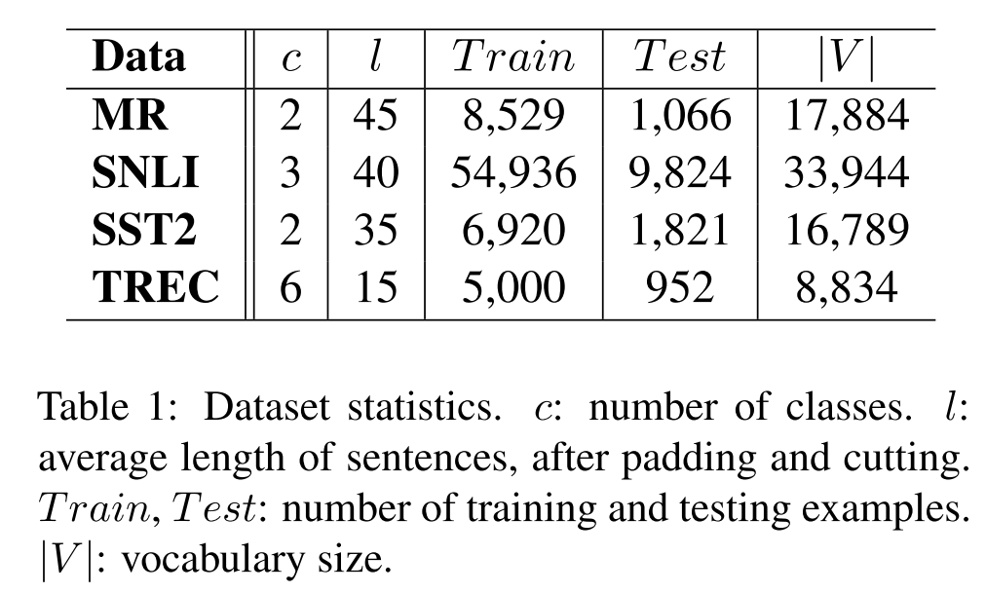
Dataset

Slide 7
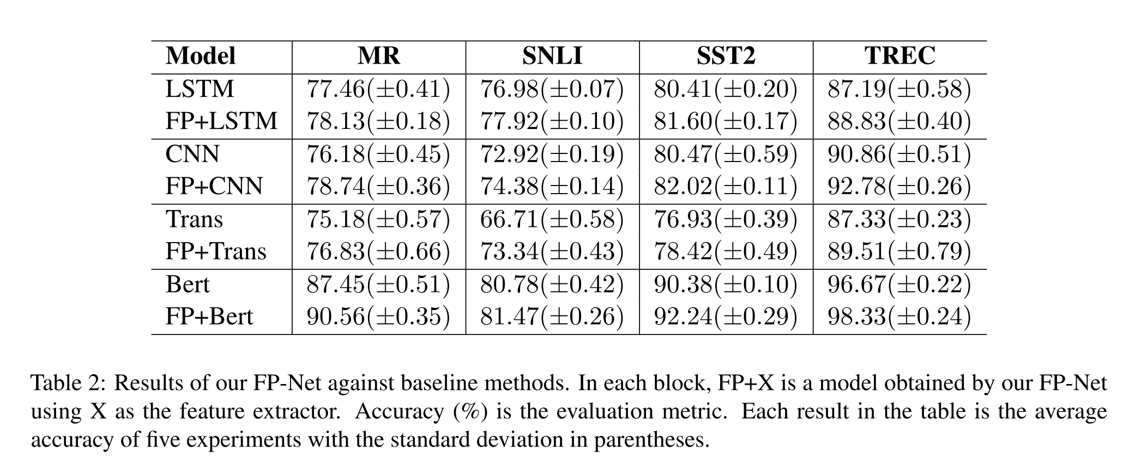
Experiment

Slide 8
Experiment

Slide 9
Experiment

Slide 10
Thanks

